Slide 1
RStudio Training Course 1

Slide 2
Outline
Let’s see how far we get:
Course/self background
R concepts
Working with data: demonstration
Processing
Visualization
Joins
Spatial data
Data Types and Structures
5) RMarkdown Documents
6) Best practices
7) Functions Continued
8) Conditionality
9) Creating Functions

Slide 3
Course Background
Goals
Provide a working understanding of R core concepts
Get familiar with basic operations of R
Learn some essential commands for A) using R in your jobs and B) making your lives easier
Specifically – replace Excel, group/write/filter datasets
There are different levels of understanding or R:
Mine: good applied understanding of R, decent understanding of core concepts, but would struggle to explain deeper concepts, and couldn’t explain underlying operations
Without knowing too much, you can do a lot to make your life easier

Slide 4
How I got into programming
My background: no programming experience in college, last year of pre-grad school job got some training in SAS, took some courses in grad school, and a lot of current job programming
But: most of learning through 1) reading The Internet 2) application to projects
Motivation for me:
1) at old job, felt like I was doing somethings inefficiently or clumsily in Excel that could probably be made easier through programming, but I didn’t know how to do it,
2) there were questions in my work I suspected would be better-answerable with data and programming, but I didn’t know how

Slide 5
Why learn some programming at all
Can make manual tasks easier by automating them
E.g. –building a car by hand vs. building a factory to make cars
Each time make car by hand room for error – whereas factory process just need get right once
Can tweak process to make different types of cars, or even planes or houses – vs. starting over
And where analogy fails – is because in this case, it’s easier to make the factory than the car by hand
Expands range of what you can do, with data especially; another tool in toolbox
Even if you don’t end up programming, understanding how it works can help you in working with data and people who know programming in future

Slide 6
Why R vs. other languages
Not too important – some people like Python or STATA – my preference for R because:
In my opinion, more intuitive and user-friendly than other languages (Python, especially compared to JavaScript and SAS)
It’s free and open source, unlike STATA or SAS
Takoma Park now somewhat invested in R

Slide 7
Core Concepts
Google is your friend
Any problems you encounter, someone else has already
Stack overflow especially – a forum for asking and answering questions about programming
Reading the documentation of a function or package can help – many come with tutorials
There are many ways to skin a…potato
Lots of different ways to accomplish the same task – some better than others, but optimizing not always worth the effort
You will try and error
Error-checking is important – R can behave unexpectedly

Slide 8
Basic data/coding concepts
Transparency and reproducibility are important
Code-review is good
Ideal: someone else can run your code with the associated datasets and get the same result
Version control good – built-in to R
Save progress at point-in-time – can revert back if necessary
Tools → Version control → Project Setup → Version control system: Git (then Google how this works)
Documentation important – to accomplish goals above

Slide 9
Final Preface
First time teaching R/RStudio; in putting together, realize breadth of things could cover – so will see how far we get, likely offer another course if interest
Bit of an odd structure – some core concepts, then jump ahead to data work/demonstrating other capabilities, then return to data work
So foundation → application → back to foundation
Idea = more useful to you to have some understanding of capabilities and core functions than to get a foundational understanding – but maybe wrongs

Slide 10
R Concepts

Slide 11
R and RStudio
R is a programming language often used for data processing, analysis, and visualization
RStudio provides a user-interface for programming in R

Slide 12
Environment, Assignment, Objects
Generally, you’ll write code to accomplish tasks in R scripts – sequences of commands you write to accomplish tasks
A good practice: use scripts to accomplish specific goals – if your script is too long, break it up into different files and organize it logically in your directory
A given R studio session exists in an environment – a sort of contained universe that starts empty but gets populated by what you do in that session
Can run multiple R sessions at once – each in its own environment
Best to organize work in R in projects – a creates a contained environment with a working directory set to the project directory
When you create a project – you can either have R create a new directory (folder), or assign it to an existing directory

Slide 13
Environment, Assignment, Objects
Things that populate the universe are objects – you create objects by assigning them values
To assign things – use `<-` or `=` in a line of code
object <- “cat”
objvec <- c(“Dan”, “Chris)
newobject = 12
objlist <- list(“Dan”, 12, T)
objdata <- data.frame(“col1” = c(1, 2), “col2” = c(“trout”, “mountain”))

Slide 14
Console
In an R script, you can run commands by highlighting them and hitting ctrl-enter; results are run and printed in the console
You can also highlight individual objects to print them to the console, and run commands directly in the console – this can be useful for viewing information about objects or testing things you don’t want in your script
If there are errors in your code or warnings, those are also printed to the console; it’s good to read both even if they can be confusing

Slide 15
Functions and packages
Functions perform a prescribed tasks, often to modify or interact with objects
For instance – printing an objects value to the console; describing what type of data an object contains; filtering a dataframe to a subset of data
In most cases, you can tell a function because it follows the format `functionname()` - but some functions do not (e.g., + is actually a function in R that behaves uniquely)
Functions are also objects

Slide 16
Functions and packages
Functions are stored in packages – collections of related functions designed to accomplish similar tasks
R comes with a set of base functions, but you can access more functions by 1) loading in packages on The Internet or 2) creating functions yourself
To load a package, you must first install it on your computer by feeding it to the install.packages() function – install.packages(“packagename”)
You can then load the package into a given R session by using the library() function – library(packagename)
You only need to install packages once per computer you’re using R on (or when you update your version of R), but you need to load packages once per session
To see all of functions in a package and help you find functions in a package, you can type the pacakgename and two colons – then Rstudio’s autocomplete should help you from there - packagename::
You can even do this for the base package – e.g., base::str(), base::sum(), base::unique()
Useful practice: use the package::function() format often – it helps you A) identify functions you’re looking for, B) you remember what functions come from where

Slide 17
Functions and packages
In most cases, functions have parameters or arguments which control how the function behaves – whether to behave one way or another
To see documentation of a function including its parameters, you can Google icompletet or type ?functionname() in the console
To see parameters and documentation of a function without searching the complete documentation, hit tab at the start of a function – e.g., sum([HIT TAB HERE]
Tab also helps autocomplete text you’re typing (object names), and lets you see documentation associated with those objects (e.g., function descriptions)
E.g.: sum(c(1, 12, 123, NA), na.rm = T) = 126 – na.rm is a parameter of sum, which tells R whether to remove missing values
whereas - sum(c(1, 12, 123, NA), na.rm = F) = NA

Slide 18
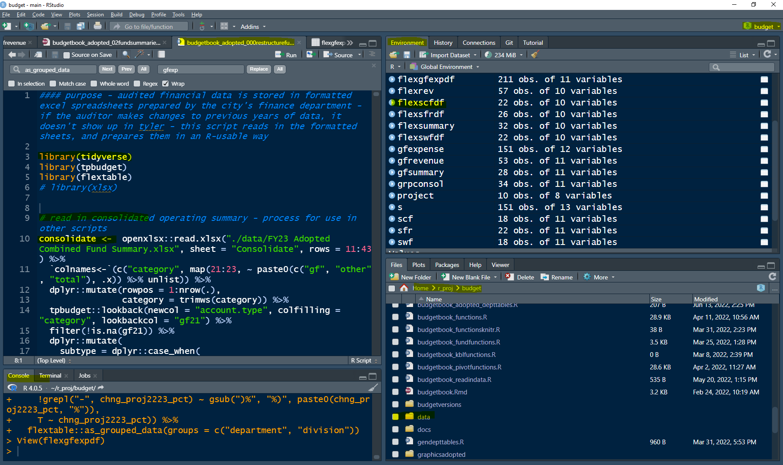
Name of R Script
Session environment window
Current project
Objects in session
environment
Read in functions in tidyverse package
Comment – starts with #, in different font
Assign dataset in Excel file to consolidate object
Project directory
Files in project directory,
including related R scripts
and data folder
Allows you to access document outline
Directory project is in
R console – with command history

Slide 19
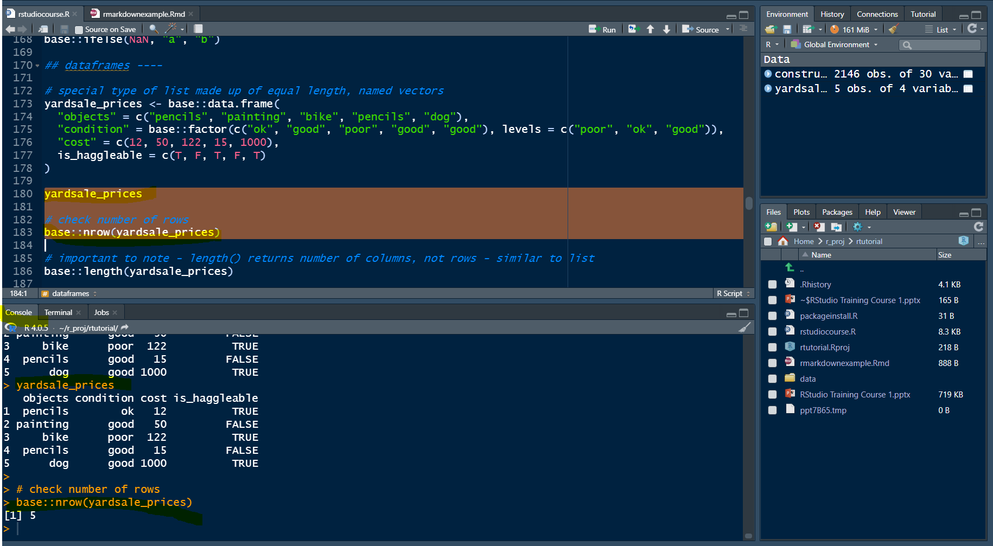

Slide 20
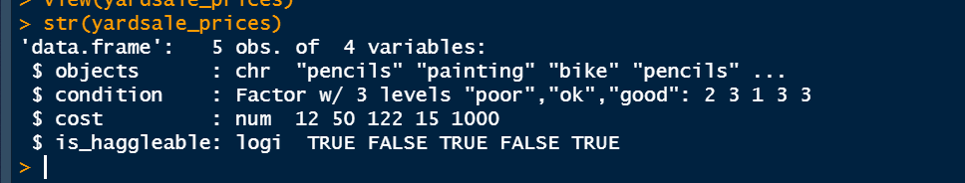
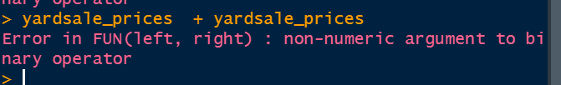

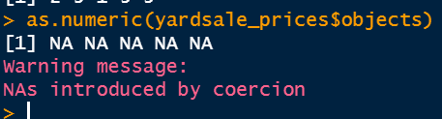

Slide 21
Previewing Dataframes and Lists
You can open a preview of dataframes (like Excel) and lists by:
Ctrl-clicking their names
Typing View(objectname) in the console
Clicking on their name in the environment pane (top right)

Slide 22
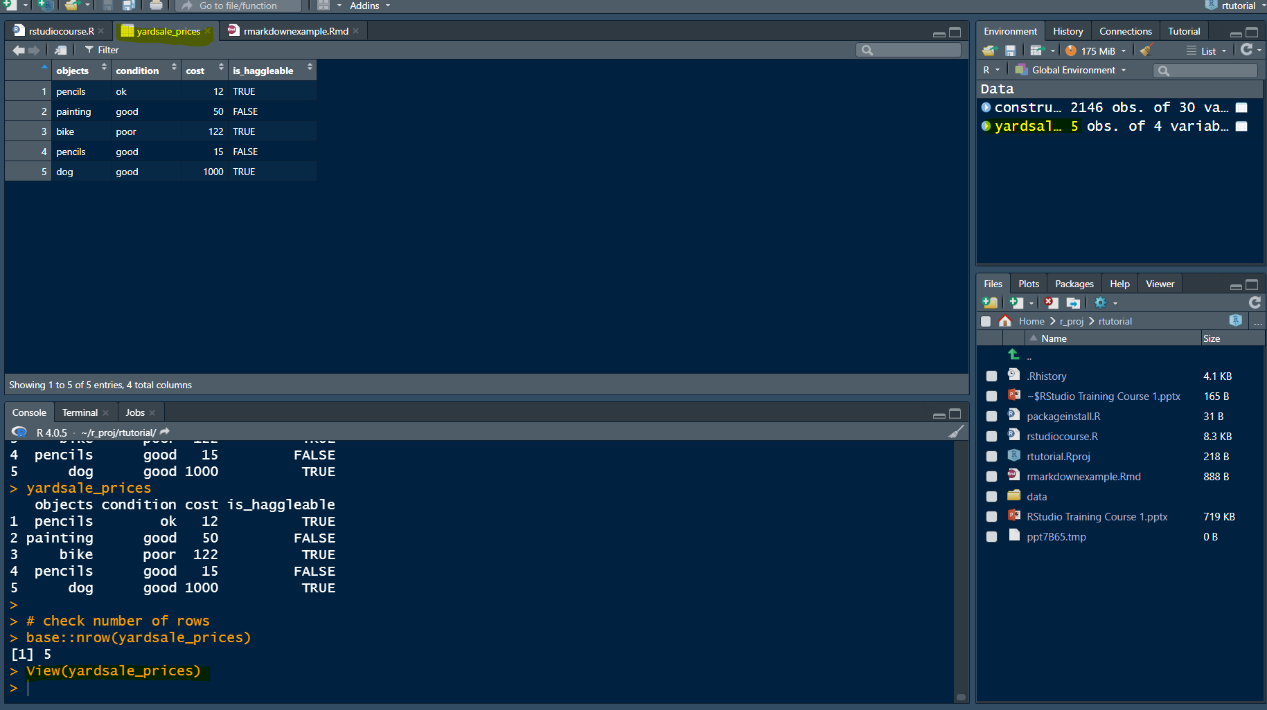

Slide 23
Basic Steps to Starting a new R Project
Open Rstudio
In the top right – click the text next to the cube with R on it, and click “New Project”
If you want to start using R in an existing folder – select “Existing Directory”
If you want to start using R in a new folder – select “New Directory”
Store any R scripts in the folder with the R project; store any data in a “data” folder you create
When you start working on this project – open the .Rproj file

Slide 24
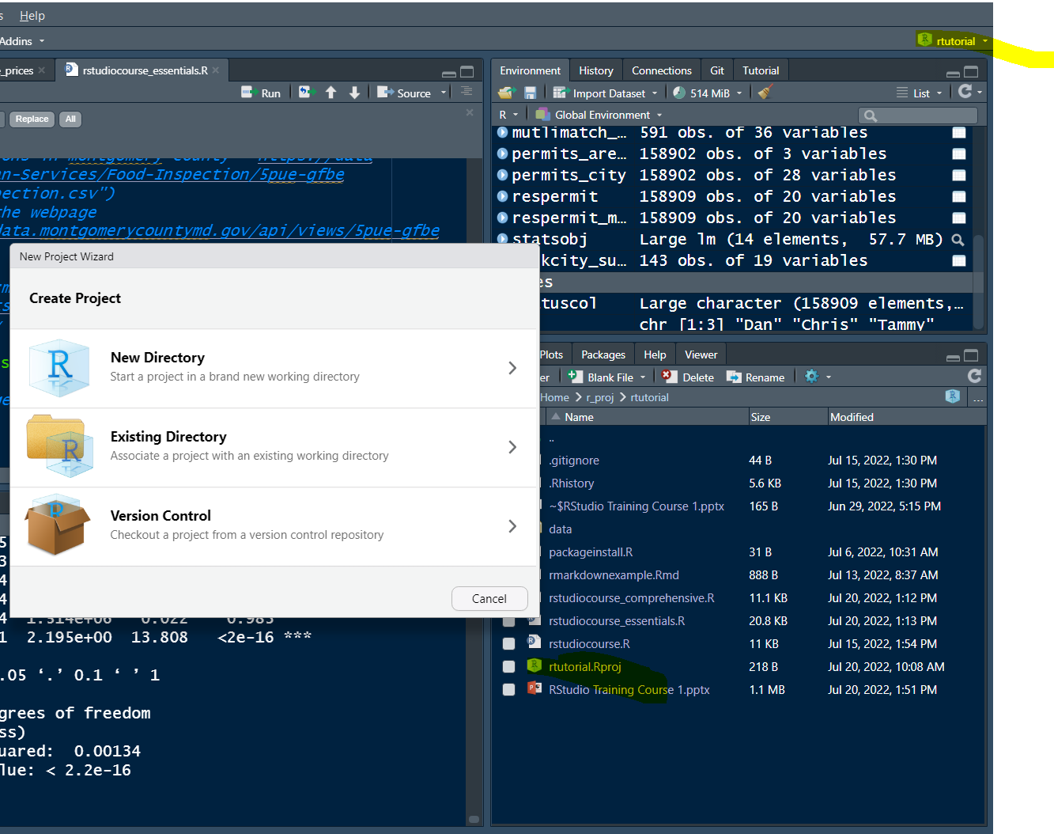
Name of project
working in; click
here to start
a new project
Select new directory or existing directory
When you work in this project again; open projectname.Rproj

Slide 25
R Script
Now – lets jump into the R Script

Slide 26
Data Types and Structures

Slide 27
Types of Data
Important
Character: “cat”, “12dog”,
Numeric: 12, 1214124, 0.12441
Integer (whole numbers): 1, 2, 10, 12
Logical: TRUE, FALSE
As numeric values – TRUE = 1 – FALSE = 0
Logical operators - ==, !=, >=, >, <=, <, grepl(), &, |, %in%
Missing (special type): NaN
Unimportant
Complex
Raw

Slide 28
Data Structures
Atomic vector – A) of length 1 or more, and B) all of the same type
“a” – length 1, character type
c(“a”, “b”, “c”, “d”) – length 4, character type
c(“a”, 5) – does not work – mixing types character and numeric (R actually converts the 5 to type character by default)
In vector of length greater than one – each item in vector is described as an element
Factor – a vector with a limited set of acceptable values (levels), that may have an order to them. By default R orders levels alphabetically
E.g. – if rating sidewalk quality – may want three levels from “Great”, “Ok”, “Poor” – and not other levels like “Goodish”
Or if have set of departments – may want factor with departments in order

Slide 29
Data Structures
List – Objects that A) can contain elements of different types, including other lists (unlike atomic vectors), B) have multiple nested-levels, and C) be named
list(124, “a”, c(“b”, “c”, “d”), list(“dogs”, 12)) – works as list, even though violates atomic vector rules
For instance – a list might store salary information on employees in different departments/divisions – e.g.:
list(“General Government” =
list(“City Managers Office” =
list(“John” = 50, “Phil” = 100, “Cathy” = 500),
“City Clerk” =
list(“Martha” = 600, “Elijah” = 150)))
Matrix – objects arranged in a 2-d rectangular layout – will skip over, since not that important

Slide 30
Data Structures
Dataframe – really – lists made up of equal-length, named-vectors (names of vectors = column names; length of vectors = number of rows)
2-dimensional object – rows and columns
Columns can be of different data types – e.g., numeric and character – but can’t mix types in one column
Can create dataframes with base::dataframe() function – or can read in from Excel, CSV, or other filetype
Can index with:
dataframe[rownumbers, columnnumbers]

Slide 31
RMarkdown Documents

Slide 32
RMarkdown Documents
RMarkdown documents intersperse code and text, allowing you to process data in the same document you visualize it, and produce PDF, Word, and HTML documents (webpages)
You can create a new RMarkdown document in R by clicking File → New File → R Markdown in Rstudio
Especially useful for – documents that are updated regularly, or documents with lots of visualizations

Slide 33
RMarkdown Documents
Code is written in code chunks – chunks are separated from the rest of the document
In the top of the document – you set the YAML – just think of as options for the document (e.g., to output as Word, PDF, or HTML, whether to include a table of contents or number sections)
Text is written in markdown format – a markup language for formatting documents
Enables very intuitive document formatting - # level one heading, ## level two formatting, ### level four heading – with built in structure for varied documents

Slide 34
Example
# This is a level one header
## This is a level two header
This is body text
```{r chunk name}
# this is a code chunk
a <- 5
a
```
Now we resume text – but **this text is bolded**

Slide 35
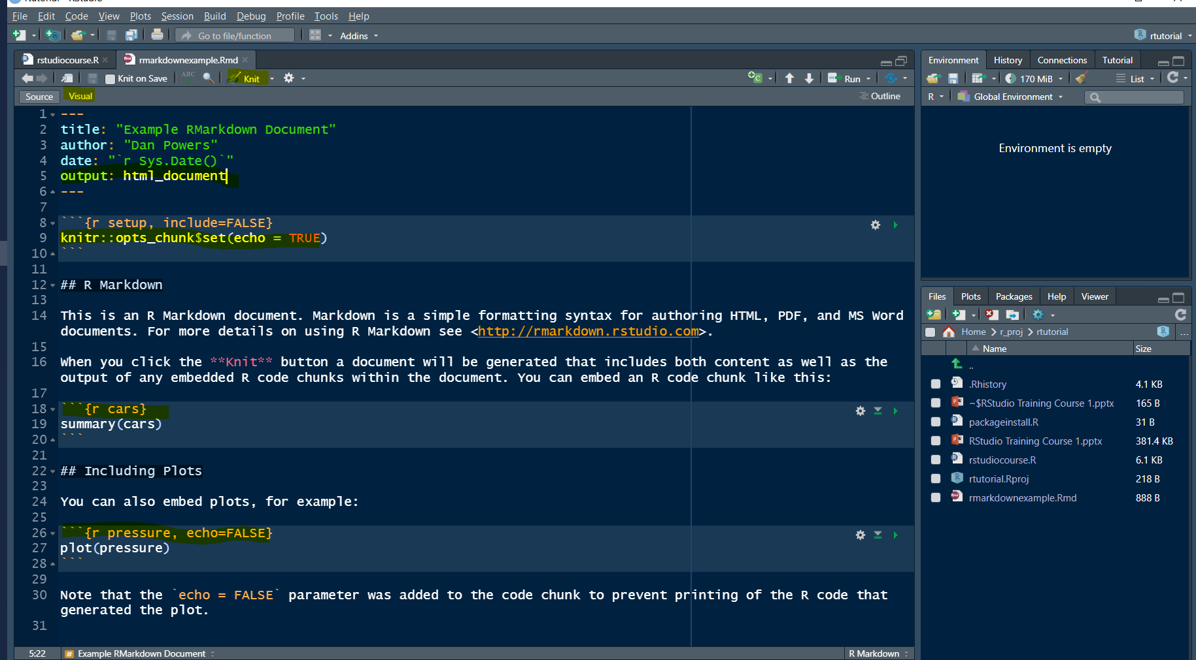
Knit button – to knit document together
Click here to switch to a preview
YAML – output set to html_document
With this function – set options for all chunks
R code chunk – can tell because it starts with three backspaces and r as first command
In code chunk heading – here change ‘echo’ option to false

Slide 36
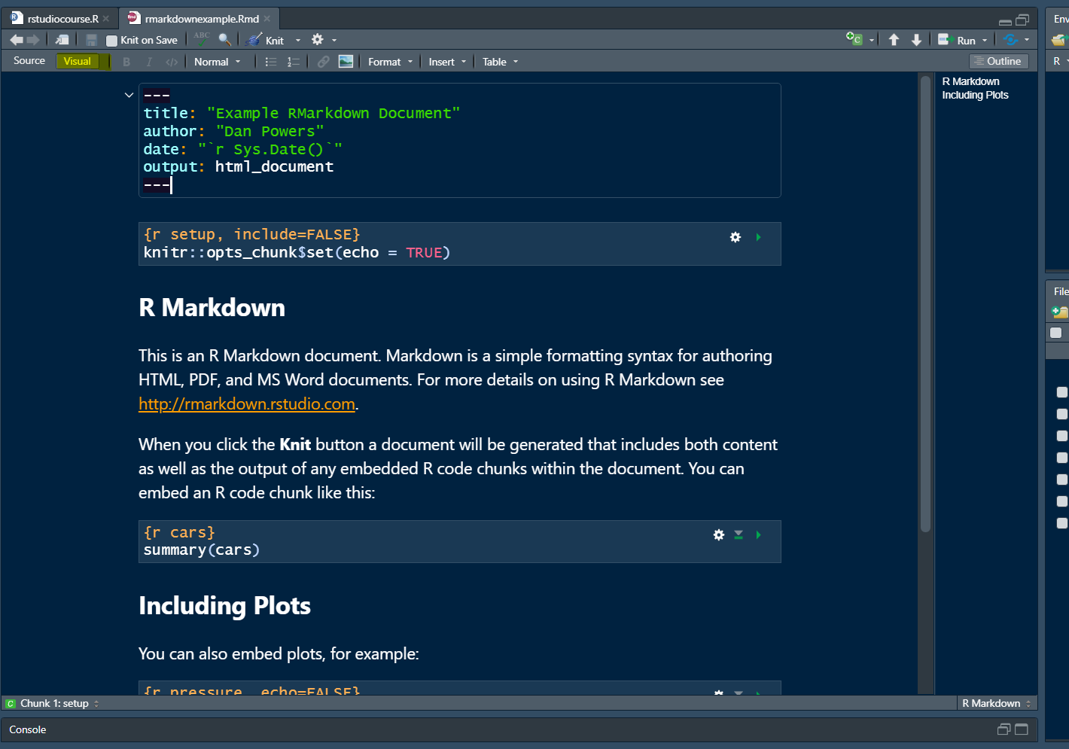

Slide 37
RMarkdown Documents
While preparing the document – you can:
Run individual code chunks – to see output for specific chunks
Knit the document together – to see results for the whole document
In the newest versions of RStudio, switch to “Visual” mode – allowing you to see a preview of the document’s appearance

Slide 38
RMarkdown Documents
For formatting output – different options depending on what want type of document you want to output
For HTML and PDF – built-in themes can set in YAML – see here
For HTML – can also define custom CSS, although a little complicated
For PDF – can also define LaTex in RMarkdown – but pain, wouldn’t advise
For Word – can create a separate Word document, define styles in that document, and read in those styles as reference_docx in YAML so output Word document matches those styles– see here for more information
If you’re ultimate goal is a PDF – can be easier to do this then export to PDF

Slide 39
Best practices

Slide 40
Misc Good Practices and things to keep in mind
Syntactically – ctrl + i automatically indents; hit enter after function command/commas to structure better – e.g.
c(sum(as.numeric(c(“12”, “240”, “500”)), c(500, 400) / 12)) harder to read than
c(
sum(
as.numeric(c(“12”, “240”, “500),
c(500, 400) / 12
)
)
Similarly – good to space things out – assign things to objects and break out rather than in one line of code – helps with debugging

Slide 41
Object naming conventions
No special characters or spaces – the object <- “512” does not work, and neither does the!object <- “512” or the?object <- “512”
As substitute for spaces – can use `_` or “.” – e.g.:
the_object <- “512”
the.object <- 512
Can’t start with number - 512cats <- “dog” doesn’t work, but cats512 <- “dog” does
Keep names brief and somewhat descriptive
test_scores <- c(90, 90, 50) better than t <- c(90, 90, 50) or test_scores_for_students_in_my_class_on_painting_cats <- c(90, 90, 50)
Avoid reusing existing functions as names – e.g., names() is a function, so don’t assign a new object to it (names <- c(“dan”, “jeff”) is bad, classnames <- c(“dan”, “jeff”) is fine
Use nouns for variable names, and verbs for function names

Slide 42
Misc Good Practices and things to keep in mind
Restart R sessions often; do not save to workspace
Be wary of missing values in your data – R can behave weirdly with missing values
5 + NaN = Na
ifelse(NaN, “a”, “b”) = NaN
“a” == 5 = NaN
To test if a value is missing – base::is.na(value)

Slide 43
Misc Good Practices and things to keep in mind
Do common-sense checks often – R won’t always give a warning or error when something weird happens or you have minor errors in your code
as.character(12, 124, 800) – returns “12” – need to wrap in vector - as.character(c(12, 124, 800))
Again, Google a lot
Look for tutorials on packages of interest – e.g., if want to start doing spatial data work, look for tutorials on spatial data work in R
Trial, err, repeat
Look at other people’s code – happy to share

Slide 44
How to Google
If you’re Googling an error – include error or warning text with function names

Slide 45
Functions Continued

Slide 46
Some good starter functions
Ctrl-enter on a highlighted object – prints the object to the console
base::print(object) – prints the object to console
base::str(object) – shows structure and basic information about an object – data-type, data-type of elements
base::head(dataframe) – prints the first n rows of a dataframe to the console
base::unique(vector) – show unique values of a vector
base::nrow(dataframe) – number of rows in a datframe
base::summary(object) – shows summary information on the object (e.g., mean median range in numeric vector)
base::paste0(obj1, obj2, “text”) – pastes together different strings with no separators
base::length(object) – length of a vector
For a dataframe – tells number of columns
base::sum(vector) – adds items in a vector
base::sort(vector) – sorts vector alphabetically or numerically
base::read.csv(filepath) – read in a csv dataframe at a given filepath (need save the file as a CSV)
base::write.csv(object, filepath) – write an object in R to a CSV file
openxlsx::read.xlsx(filepath) – read in .xlsx document at a given filepath

Slide 47
Good starter functions
base::grep(pattern, character_vector) – uses regular expressions to match strings in R – pretty confusing but useful – returns positions or values of matching strings in vector
base::grepl(pattern, character_vector) – similar to base::grep(), except returns TRUE/FALSE of whether there’s a match
%in% - special infix function – tests if string vector is in another string vector
“cat” %in% c(“dog”, “cat”) – returns TRUE
c(“cat”, “wolf”) %in% c(“wolf”, “dog”, “fish”, “hog”) – returns c(FALSE, TRUE)
stringr package functions – other string matching functions that are a little more intuitive

Slide 48
tidyverse and dplyr package
tidyverse = set of packages can load in with library(tidyverse) that are good for working with data
dplyr in particular – makes your life much easier when working with data

Slide 49
piping
%>% piping function – makes it easier to sequence functions in a row to accomplish related tasks, especially with data – what it does is feed the object to the left side of the pipe as the first argument to the function on the right side of the pipe
The first argument to many dplyr functions is a dataframe – so piping makes it easier to sequence changes to a dataframe – so
dataframe %>% mutate(newcol = 5) – feeds the dataframe as the first argument to dplyr’s mutate function – the same as mutate(dataframe, newcol = 5)

Slide 50
These two are identical – which is easier to read
dataframe %>%
dplyr::mutate(newcolumn = oldcolumn + 4) %>%
dplyr::filter(newcolumn == 9) %>%
dplyr::groupby(cartype) %>%
dplyr::summarize(totalnew = sum(newcolumn))
summarize(groupby(filter(mutate(dataframe, newcolumn = oldcolumn + 4), newcolumn == 9), cartype), totalnew = sum(newcolumn))

Slide 51
Functions and packages
Vectorized functions – most R functions are vectorized, which means they operate on all elements of a vector without needing to loop through them
So:
5 + 1 = 6
c(5, 12, 4) + 1 = c(6, 13, 5)
str1 <- “fish”
str2 <- c(“fish”, “orangutan”, “walrus”)
base::paste0(“I like “, str1) = “I like Fish”
base::paste0(“I like “, str2) = c(“I like fish”, “I like orangutan”, “I like walrus”)

Slide 52
Conditionality

Slide 53
Conditionality
Can use if/else statements to tell R to do things under certain conditions – can even nest if else statements in other statements
Format:
if (logical_condition) { sequence of commands }
else if (logical_condition) { sequence of commands }
else { sequence of commands}
Don’t need to use else or else if – in general though, better to use else if than else to make sure R behaves as you want

Slide 54
Conditionality
Conditionality is especially useful in functions, but can also be useful to create error conditions in your script with base::stop(“Error message”), base::warning(“Warning message”), and base::browser()
You try to predict what your code will do but don’t always know – or you might be working with data you’re checking for errors - so you might want to build in sequences
E.g. – after you do something to a vector, you might want to check if any missing values are in the vector, and stop the sequence if not
E.g. – if you’re reading in a dataset, you might want to make sure it has as many rows as you’re expecting

Slide 55
Creating Functions

Slide 56
Creating Functions
Can create functions to accomplish multi-step tasks in one step
Basic format:
functionname <- function(parameters) {
# function body
}
Then to call function
functionname(parameters = object)

Slide 57
Sources
https://www.datanovia.com/en/blog/r-coding-style-best-practices/#:~:text=Syntax-,Object%20naming%20convention,function%20names%20should%20be%20verbs
Advanced R Book
Rmarkdown Book

